Slide 1


Visual Analytics Project Paolo Caruso 1843152 Cristian Fioravanti 1861593
Visual Analytics

Slide 2

Dataset

Slide 3

Dataset: Google play store app
How we get the dataset?
Link:
https://www.kaggle.com/nba-aba-baa-stats

Slide 4
In particular, for each application, data from 13 different features are reported, and we have chosen the 9 most interesting and useful for the data analysis:
App: Name of the application.
Category: Application category (e.g., "GAME," "BOOKS AND REFERENCE," "EDUCATION").
Rating: Application rating on a scale from 1.0 to 5.0.
Reviews: Number of reviews received.
Size: Size of the application in kilobytes (kB).
Installs: Number of installations, rounded to the lower power of 10.
Price: Price of the application.
Type: Type of application (free or paid).
Content Rating: Age classification of the application (Teen, Adults only, Mature, Everyone 10+, Everyone).
The excluded features are
Last Updated: Date of the last update of the application.
Current Ver: Current version of the application.
Genres: Genres of the application.
Android Ver: Minimum required Android version for the application.

Slide 5
Data Manipulation/Preprocessing

Slide 6
We remove the rows with NaN values in Rating and Size columns and the incomplete rows to maintain data integrity.
Removal of unnecessary characters:
Size column: kb or MB indicators.
Price column: Dollar symbol ($).
Installs column: Plus symbols and commas between digits.
Performing of Dimensionality Reduction (PCA), Considered only continuous columns (Rating, Reviews, Size, Installs, Price). Omitted categorical columns (App, Category, Type, Content Rating).

Slide 7
5 Sections

Slide 8
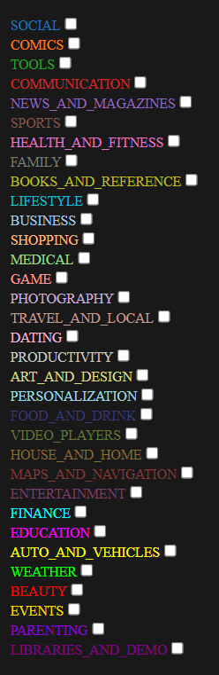
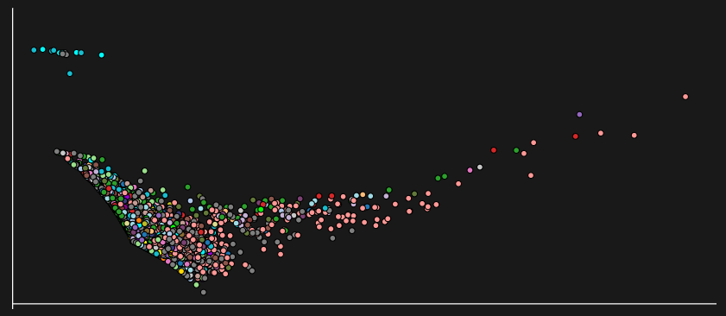
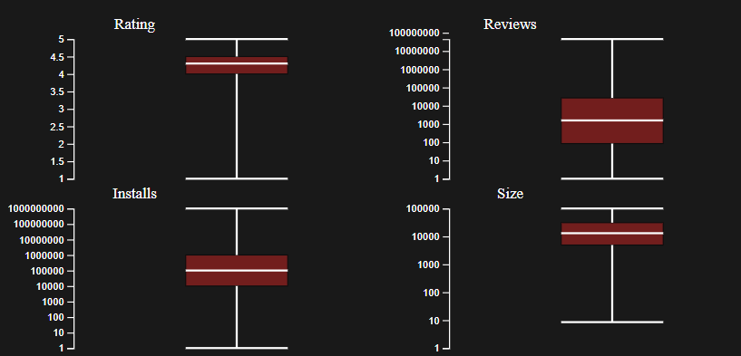
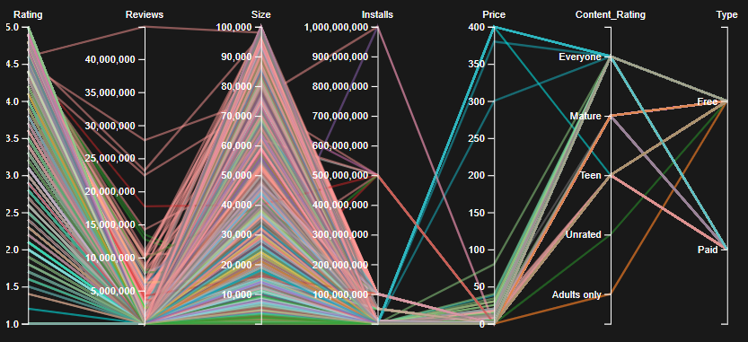
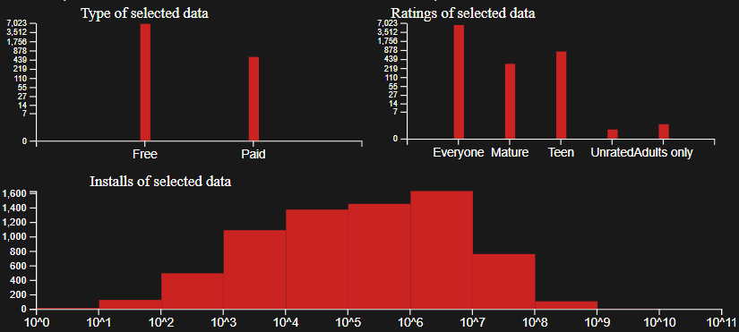

Slide 9
Two type of modality

Slide 10
Two type of modality
Visualize

Slide 11
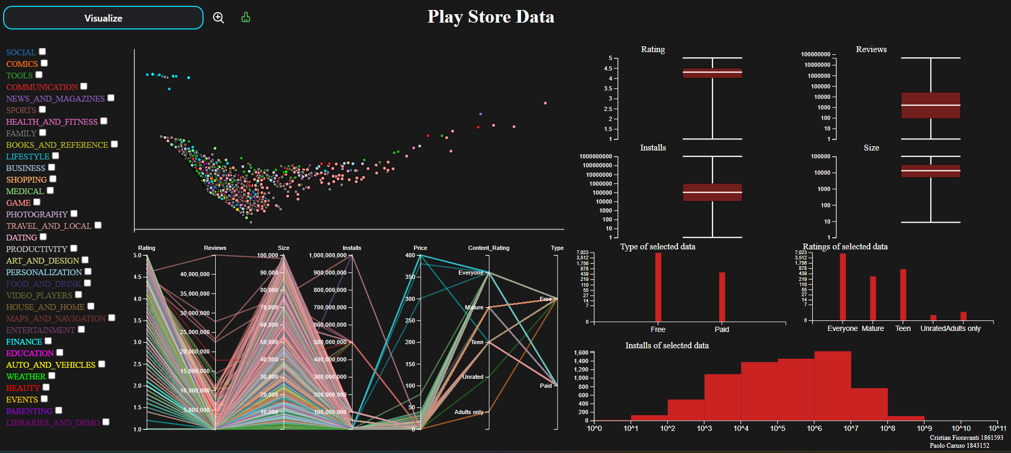
Visualize

Slide 12
Category Selection:
Choosing a category from the list highlights applications in that category on the ScatterPlot that are not already selected.
Adding these applications to the selected ones updates the Histogram data in real-time.
Deselecting a category unselects all applications previously selected in that category, removing their highlighting.
Mouseover on ScatterPlot Elements:
Displays the features of the selected element.
Brush on ScatterPlot:
Selecting an area on the ScatterPlot adds the included applications to the already selected ones.
Histogram data is updated in real-time.
Only one brush is allowed in this mode.
Brush on Parallel Coordinates:
Highlights in YELLOW the applications already selected on the ScatterPlot.
Performing multiple brushes on different features highlights only the selected applications that satisfy all chosen criteria.
It is possible to deselect and move the already made selection on each axis.

Slide 13
5. BoxPlot Section Selection:
Clicking on one of the 4 sections of a BoxPlot highlights in yellow the already selected applications that have the value of that category within the range represented by the selected section.
Clicking on multiple sections of the same or different BoxPlots highlights only the selected applications that agree with all the chosen value ranges.
The user-selected portion is highlighted with the same color as the BoxPlot but in a more intense shade.
6. Mouseover on BoxPlot Sections:
Hovering over each of the 4 sections of a BoxPlot shows a tooltip with detailed information about the number of applications that meet or do not meet that specific constraint.
7. Mouseover on Histogram Rectangles:
Hovering over each rectangle in the 3 available views shows a tooltip displaying the value represented by that rectangle and thus the number of applications with that value on the x-axis.

Slide 14
Two type of modality
Compare
Notes:
The compare mode born from the need to be able to work more with the data and furthermore analyze the trends that different applications have in common or not with other applications

Slide 15
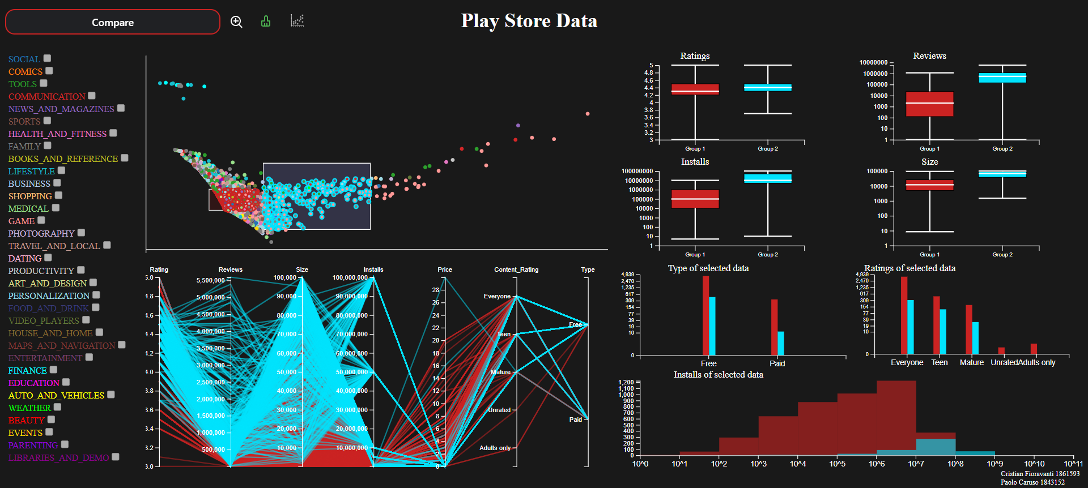
Two type of modality
Compare
Notes:
So we build this mode and the result is it.
The selection can take place in different ways as already seen for visualize mode. We can brush on the scatterplot or also select the app from the category thanks to the checkbox.
On the right side, each component: the boxplot, the histograms, and the parallel coordinates permit a clear representation of the two groups selected.
In this mode is also present a new feature that is not present in the visualization mode and is the possibility to recalculate the PCA only for the set or sets selected by the user, this permit to focus on a more detailed anazlysis of the data and can help the user to see in a clear way the main characteristic of the specific set

Slide 16
Category Selection and Deselection:
Selecting a category from the list selects applications belonging to that category as a group to compare.
Deselecting a category removes those applications as a group to compare and also deselects them on the ScatterPlot.
Mouseover on ScatterPlot Elements:
Retains the behavior of the "Visualize" mode.
Brush on ScatterPlot:
Sets the included applications in the selection as a group to compare.
It is possible to perform a maximum of two brushes in this mode (one for each group). If a category has already been selected as a group, only one brush is allowed.
Notes:
These are some of the all interactions possibile in this specific mode and we will see all of them during the demo part. Like in the previous mode, we can see that, is possibile to brush the scatter plot for select the two set
But also (NEXT PAGE)

Slide 17
4. Recompute PCA:
Once two groups are selected, clicking the button next to the ScatterPlot recalculates the PCA on the data of the applications in the two groups and updates the ScatterPlot with only the circles of those two groups.
5. Brush on Parallel Coordinates:
Retains the behavior of the "Visualize" mode.
6. Mouseover on Histogram Rectangles:
Retains the behavior of the "Visualize" mode.
Notes:
Here we can see the possibility to perform the PCA for the two groups selected. The compare mode permit to brush the parallel coordinates in order to underline all the circle that are inside the constraint and mantain the mouseover interaction with the histrogram rectangle like in the visualization mode

Slide 18
Insights
Notes:
With this mode we can discover many insights
The first one we propose is the following: (NEXT PAGE)

Slide 19
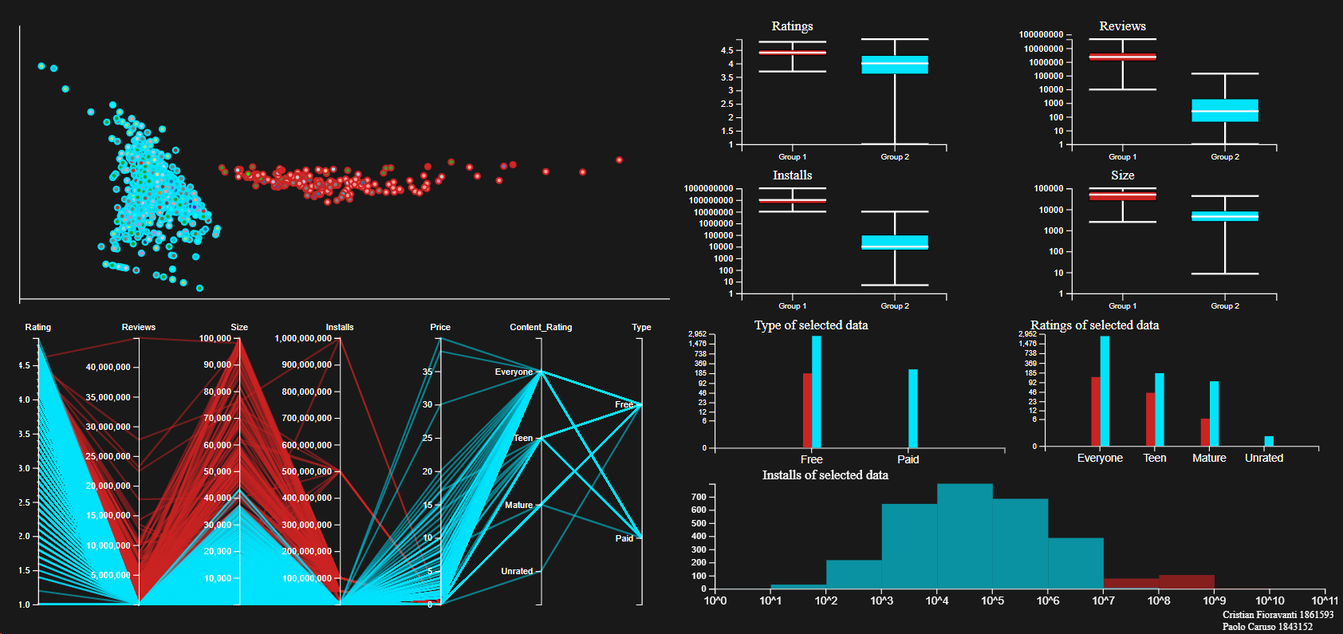
less installed
Boxplots for reviews in both groups show significant differences.
Quartile values (Q1, Q3) for highly installed apps are 1,000,000 and 5,000,000.
Quartile values (Q1', Q3') for less installed apps are 0.005% of Q1 and about 0.1% of Q3.
highly installed
Less installed apps have notably fewer reviews, indicating a lower user engagement compared to popular apps.
Highly installed apps, for the rating data, show a concentrated distribution with quartiles ranging from 3.7 to 4.8, suggesting consistent high-quality reviews.
Less installed apps exhibit a wider distribution across all ratings (1 to 5), indicating greater diversity in user opinions.
The broader distribution for less installed apps may be due to factors such as lower quality or a limited number of user votes, leading to more varied scores.
Notes:
In this example we have selected two groups thanks to the help of the visualization mode and we have recompute the PCA in the scatterplot, the two groups are:
The less installed apps in light blue
The highly installed apps in red
The first difference between the two groups is that each of them is located in a differente portion of the scatterplot
After that analyzing deeply the boxplot data, we can say that the quartiles Q1 and Q3 for highly installed apps are around one-million and five-million, this means that seeing the values for the quartiles of the least installed apps the Q1’ is equal to the 0.005% of Q1 and Q3’ is equal to the 0.1% of Q3
The next one, if we look the rating data in the boxplot the highly installed apps show a concentrated distribution ranging from 3.7 to 4.8, suggesting consistent high-quality reviews on the other hand less installed apps exhibit a wider distribution across all ratings (1 to 5), indicating greater diversity in user opinions.
The wide distribution for less installed apps it may be possible due to two factors:
First one is a lower quality, so they take a low rating
The second one is that a limited number of user votes can permit to reach easily high rating, thanks to friend and family for example

Slide 20
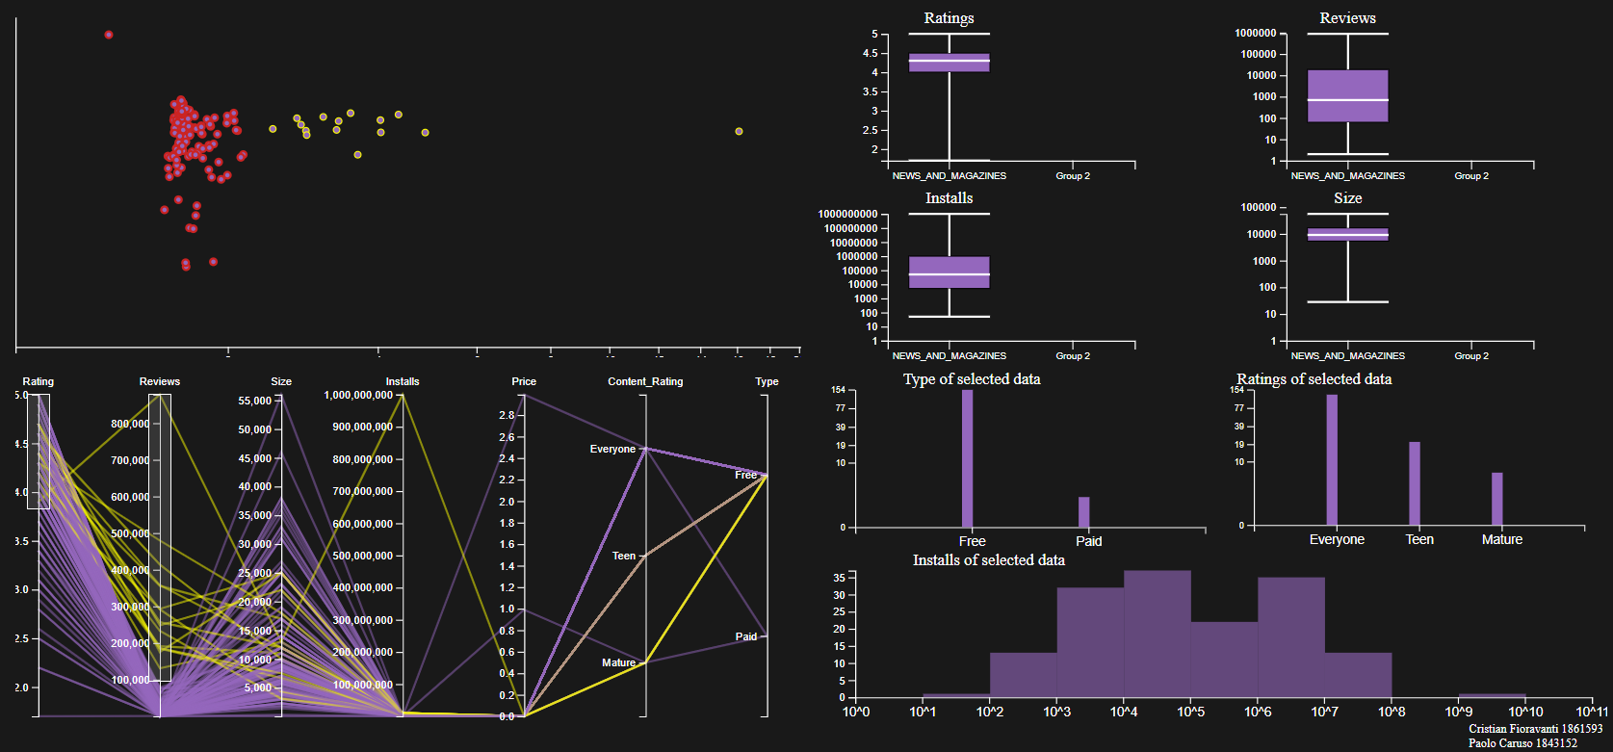
Analysis of the NEWS_AND_MAGAZINE
1. Installation Dynamics:
- Ratings have minimal impact on installations.
- User reviews play a pivotal role.
2. Popular Apps:
- Widely appreciated apps have 100,000 to 900,000 reviews.
- Ratings fall within the range of 4 to 5.
3. Less-Installed Apps:
- Accumulate fewer reviews (0 to 100,000).
- Variable ratings ranging from 1 to 5.
Exception:
- Google News app:
- Despite a rating of 3.8, maintains top position in user installations.
- Exemplifies unique appeal and resilience.

Slide 21
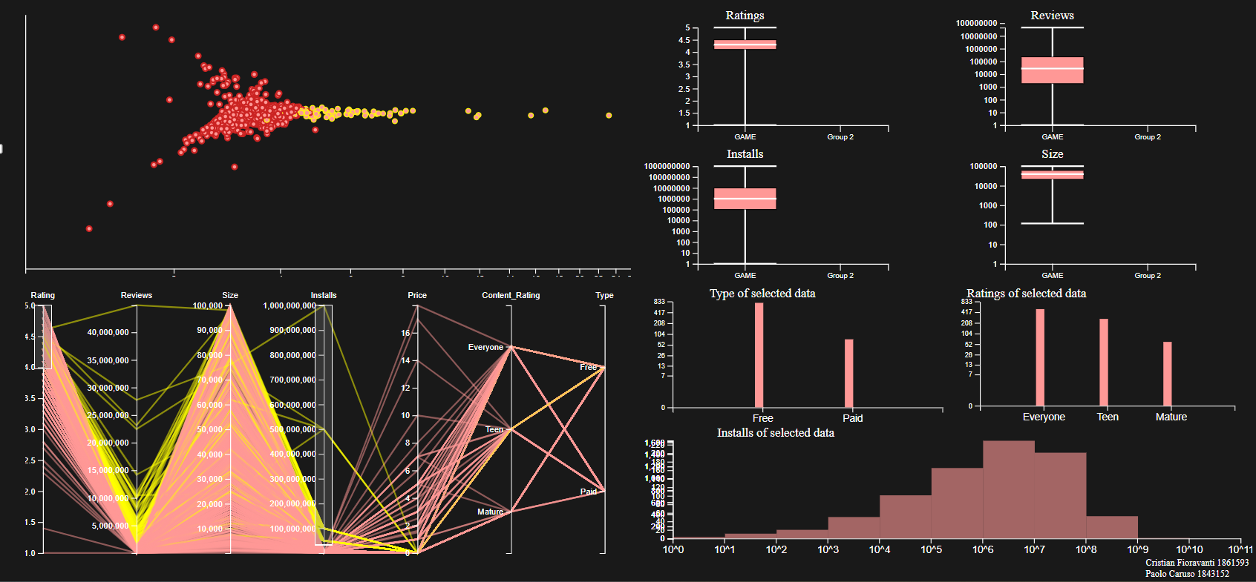
Analysis of the GAME
1. Rating Importance: Optimal apps have ratings between 4 and 5.
2. Size Impact: App size doesn't significantly influence installation decisions.
3. Review-App Popularity: Reviews appear proportional to the app's popularity.

Slide 22
Related Work

Slide 23
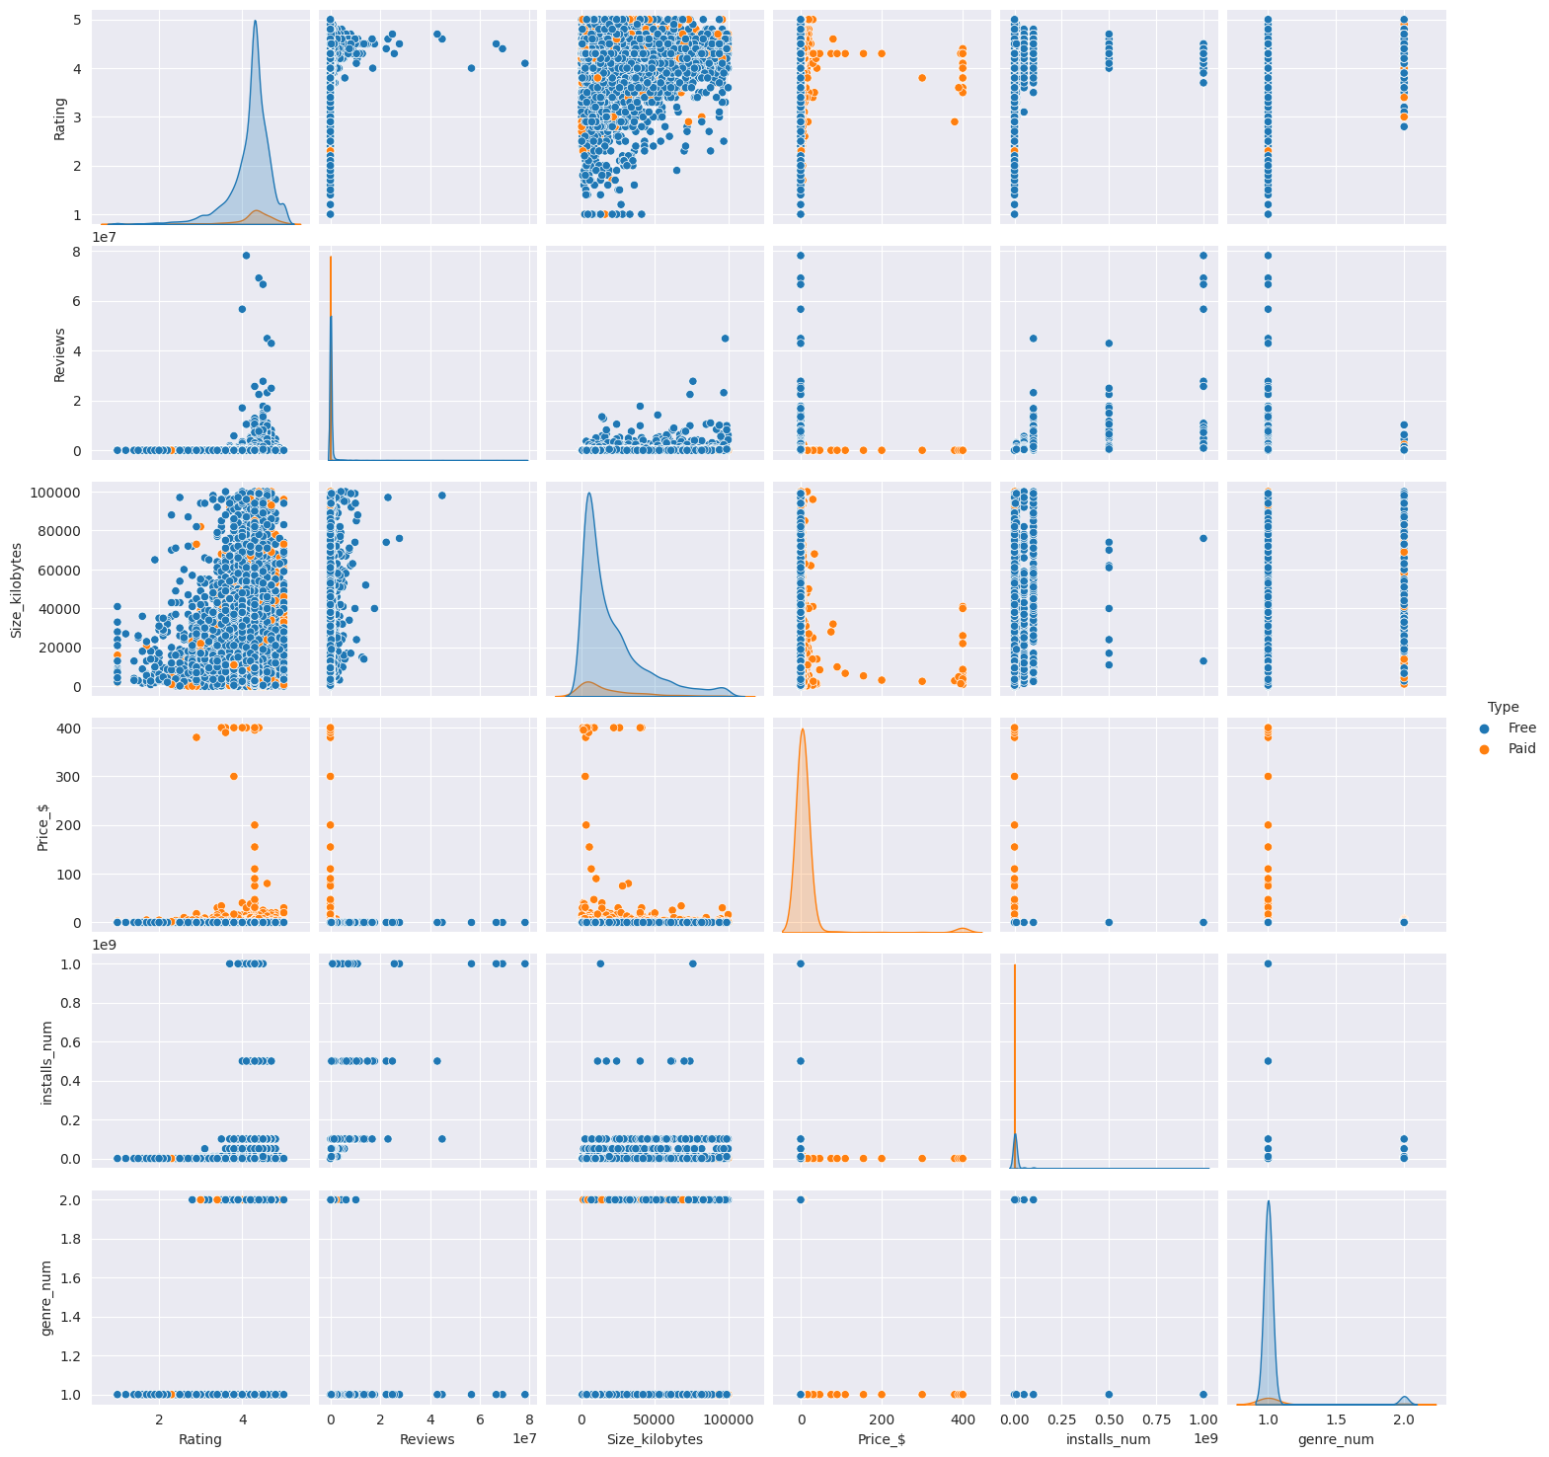
Most studies on the dataset focus on Data Visualization rather than Visual Analytics.
We cannot talk about the contribution of Aiastan Sherniiazov with his work: “How To Make Your App Popular?”
Relevant findings:
A high number of reviews is correlated with a higher number of installations.
User feedback is crucial for the success of an application.
Applications with higher ratings tend to be installed more frequently
Notes:
the correlation between reviews and installations
the significance of user feedback
the impact of higher ratings on app frequency

Slide 24
Future Developments
Notes:
Some of future developments can be: (NEXT PAGE)

Slide 25
User-Defined Histograms:
Allow users to choose displayed histogram types.
Enhanced Selection Modes:
Implement selection from Parallel Coordinates or Boxplot.
Customized Scatter-Plot:
Add/remove apps for personalized views.
Notes:
For Example
Allow users to choose displayed histogram types.
Implement selection from Parallel Coordinates or Boxplot
Add or remove apps for a personalized views.
And this is it, now we can start the Demo Part

Slide 26
End

Slide 27
Start Demo Part
Paolo Caruso 1843152 Cristian Fioravanti 1861593

